Slide 1
🔥BALLIT🔥
Low-fi Prototype

Slide 2
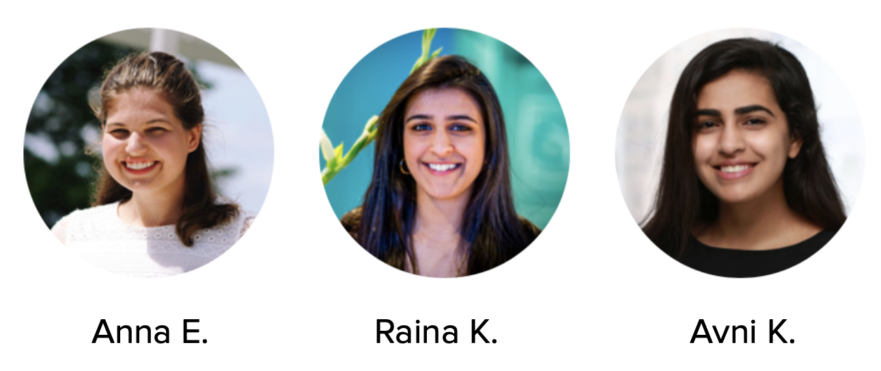

Slide 3
Where we’re going...
Mission Statement
01
Prototype Overview
02
Results and Next Steps
03

Slide 4
Problem:
Political information is not geared towards Gen Z

Slide 5
Streamline political information and empower young voters to shape their own future.
Notes:
Value proposition

Slide 6
Strengthening democracy by including young voters.
Notes:
Value proposition

Slide 7
Where we’re going...
Mission Statement
01
Prototype Overview
02
Results and Next Steps
03

Slide 8
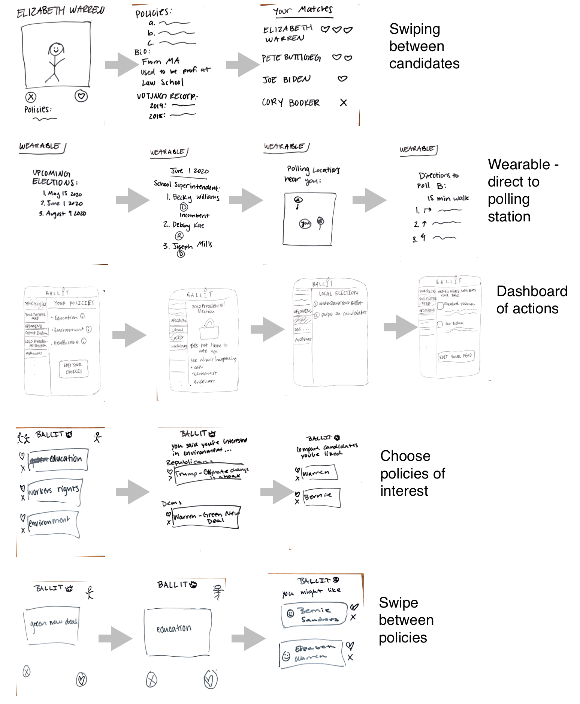

Slide 9
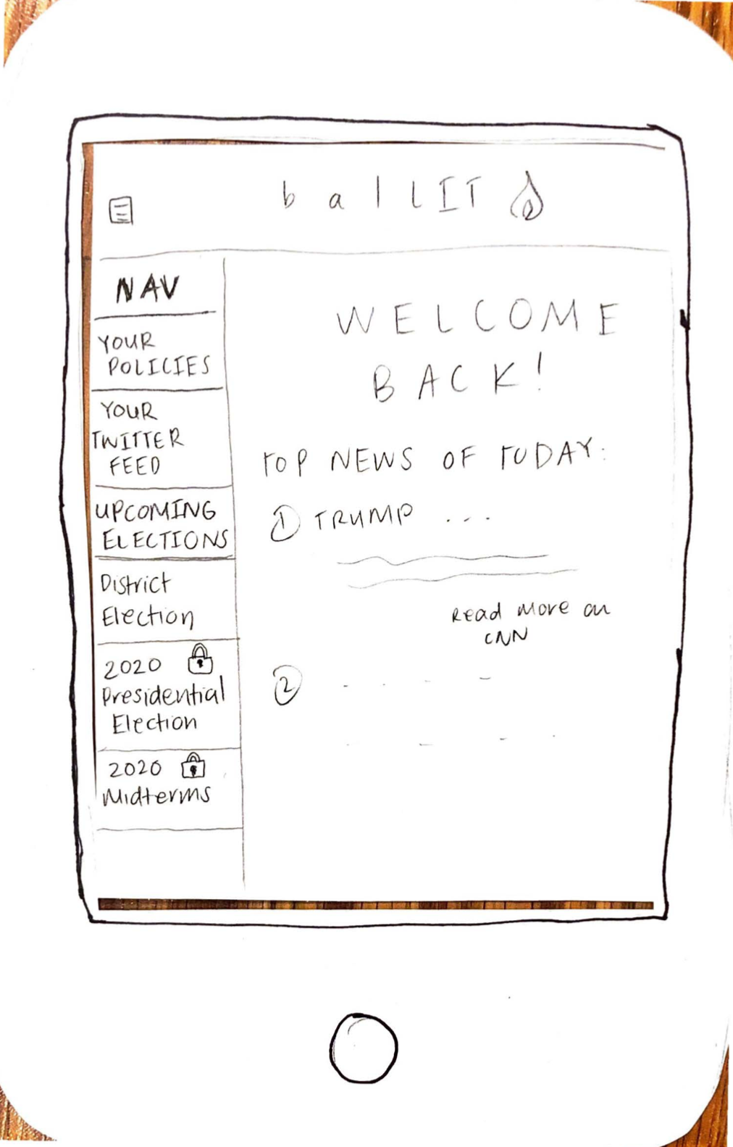
Selected Interface
Dashboard of Choices
Gamification of choices
Lots of necessary information
Notes:
Easy to navigate
Consolidates information from multiple sources well
A lot of relevant information
Organized by time frame
Integration with social media (Twitter)
Potential for information overload
Not as fun/appealing to Gen Z
Users need to manually change preferences

Slide 10
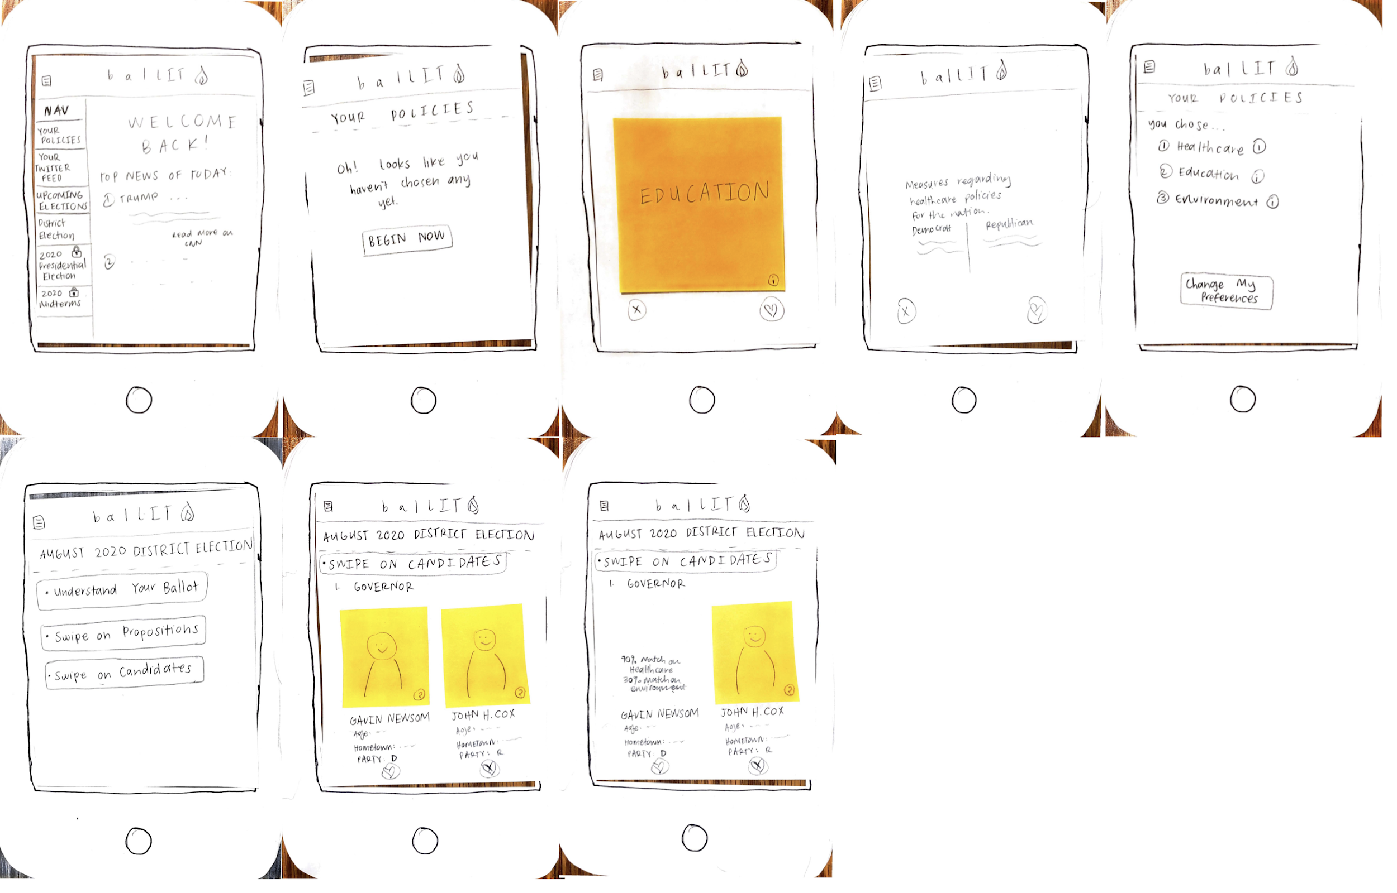

Slide 11
Task One: Choose Policies

Slide 12
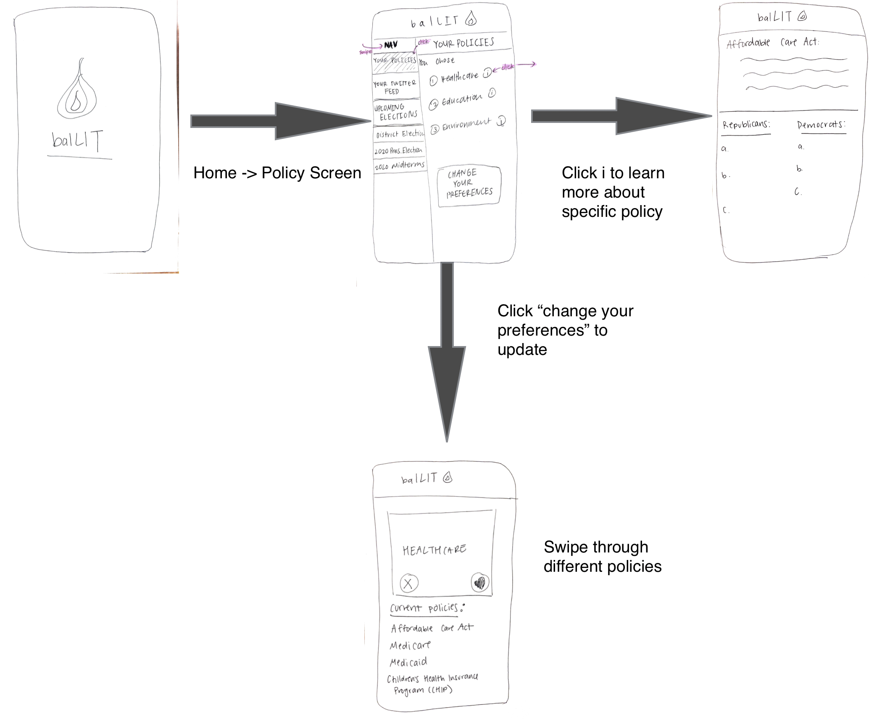

Slide 13
Task Two: Discover Candidates

Slide 14
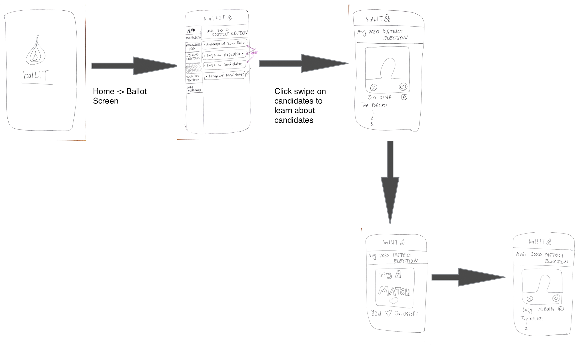

Slide 15
Task Three: Compare Candidates

Slide 16
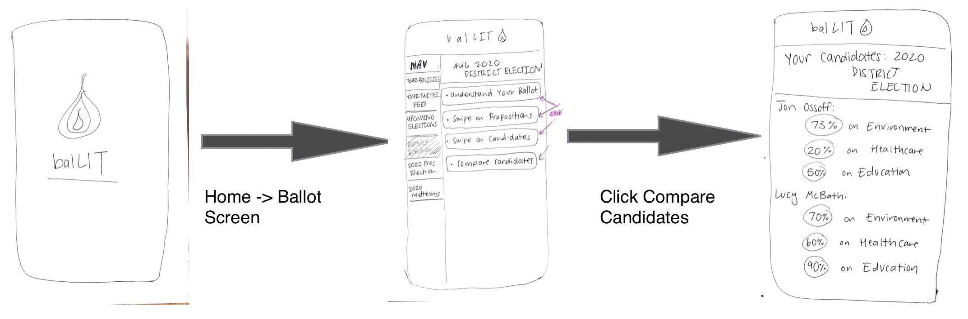

Slide 17
Where we’re going...
Mission Statement
01
Prototype Overview
02
Results and Next Steps
03

Slide 18
Experimental Methods
Stanford Junior
Palo Alto High School Senior
Stanford Sophomore
Tests carried out in a quiet environment
Analyze interactions to understand pain points
Notes:
tasks completed
user enjoyment
explore the interface
anna computer, raina facilitator, avni observer

Slide 19
Experimental Results
Task One
Successfully completed task
Doesn’t differentiate policies for different politics
Swiping was fun

Slide 20
Experimental Results
Task Two
Successfully completed task
No correlation between discovering candidates and chosen policies
Enjoyed the twitter feed integration

Slide 21
Experimental Results
Task Three
Successfully completed task
Users felt task was redundant with task two
Preferred the personalization of this screen

Slide 22
Suggested UI/UX Changes
Cleaning up sidebar
Policies needs party-specific rework
Swiping is fun, but not continuous
Integrate policy updates

Slide 23
Where we’ve been...
Mission Statement
01
Prototype Overview
02
Results and Next Steps
03

Slide 24
Thanks!
Does anyone have any questions?

